Slide 1
COURSERA CAPSTONE
SEATTLE MEXCIAN PROJECT

Slide 2
Introduction
A business owner is looking to open a Tex-Mex restaurant in Seattle or one of its accompanying suburbs. Which area of the city is best to open a their restaurant?

Slide 3
Data Needed
List of neighborhoods and their coordinates near Seattle
Geocoordinates of neighborhoods near Seattle
Restaurants located within each neighborhood

Slide 4
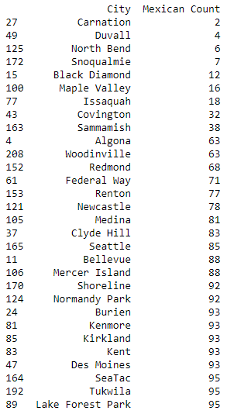
CITIES REVIEWED

Slide 5
Results
Overall, the results were varying with some cities in Seattle showing a very large amount of Mexican restaurants will a few pockets remaining for opportunity.

Slide 6
Future Recommendations
In the future, other variables could be used to increase accuracy. Population and demographic information could help explain why certain cities have a large/minimal amount of restaurants. It also would be helpful to find specific neighborhoods within cities that are high population that are missing certain restaurant types.

Slide 7
Conclusion
Based on the above results, Carnation is the best city to open a Mexican restaurant. These results will be based on lowest competition alone. Duvall and North Bend are the next best options for opening a restaurant.

